Slide 1




MMES WOMEN’S ARTS AND SCIENCE COLLEGE -THIRUVALLUVAR UNIVERSITY
NAME : AAISHA M
REG NO : 34624U09001
DEPT : BCA – ‘A’ (II-YEAR)

Slide 2




DIGITAL PORTFOLIO
Include a concise description outlining the objective of the presentation.

Slide 3
AGENDA :
1.Problem Statement 2.Project Overview 3.End User 4.Tools & Technologies 5.Portfolio design and Layout 6.Features & Functionality 7.Result & Screenshot 8.Conclusion 9.GitHub Link

Slide 4


Slide 5
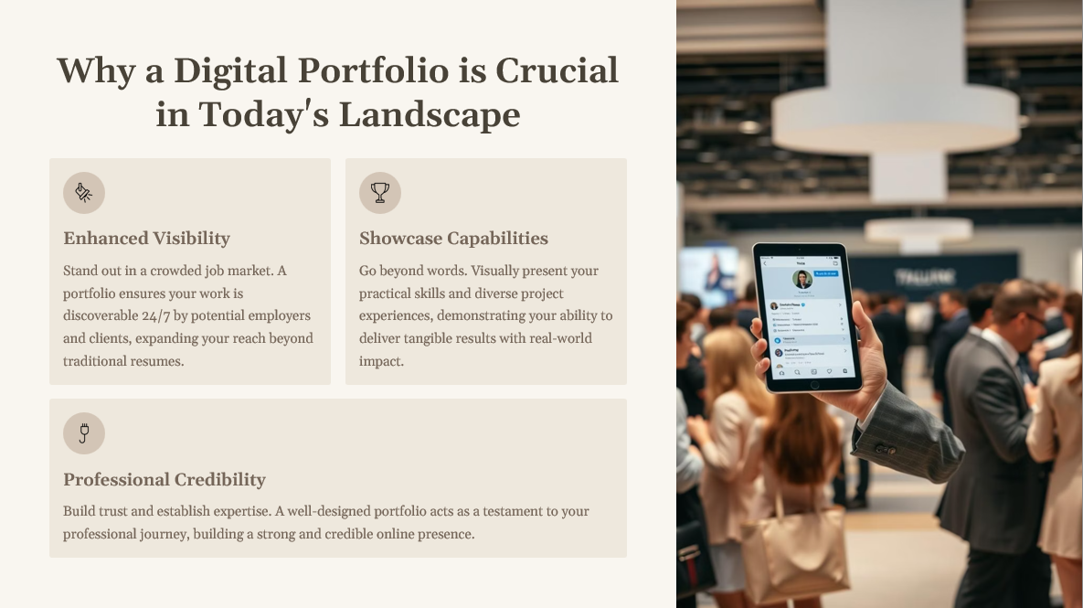

Slide 6
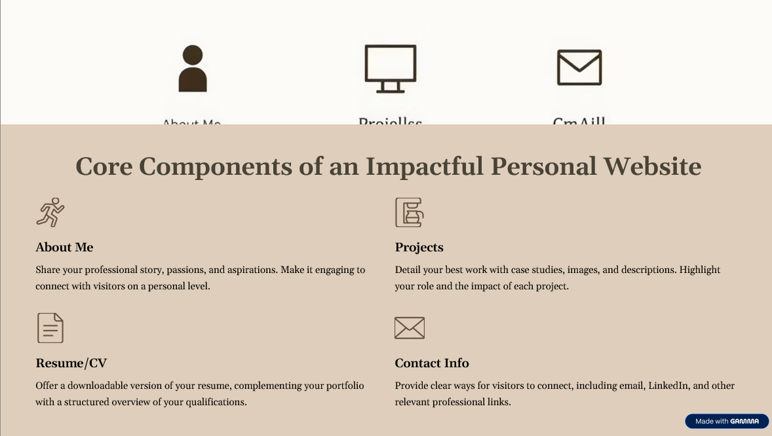

Slide 7
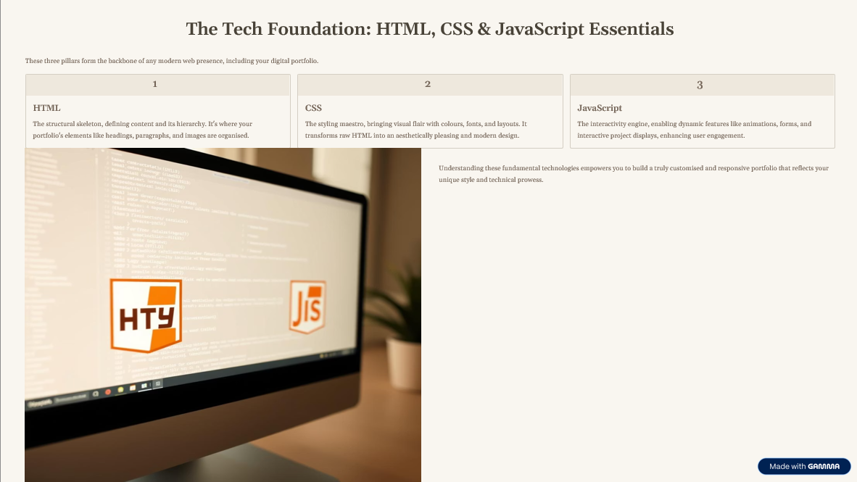

Slide 8


Slide 9
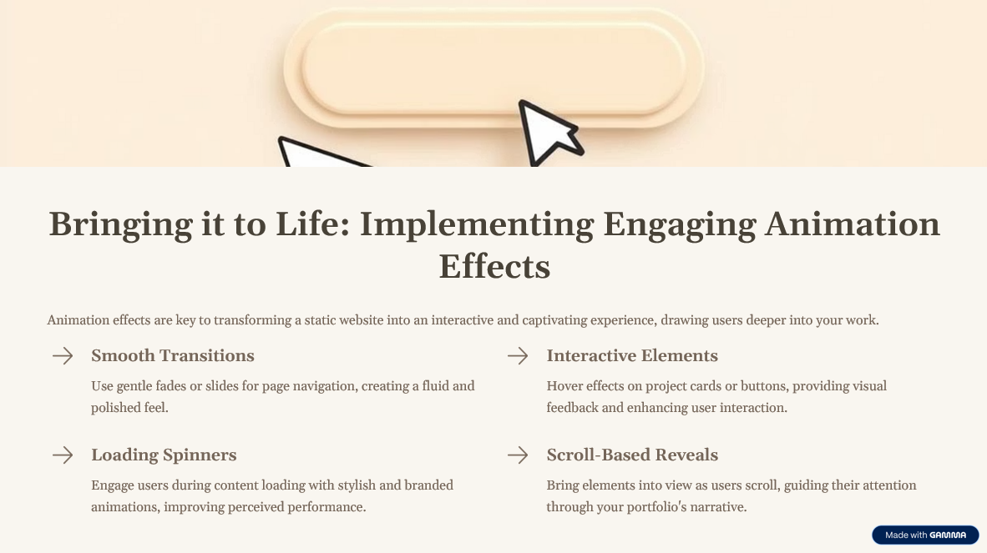

Slide 10
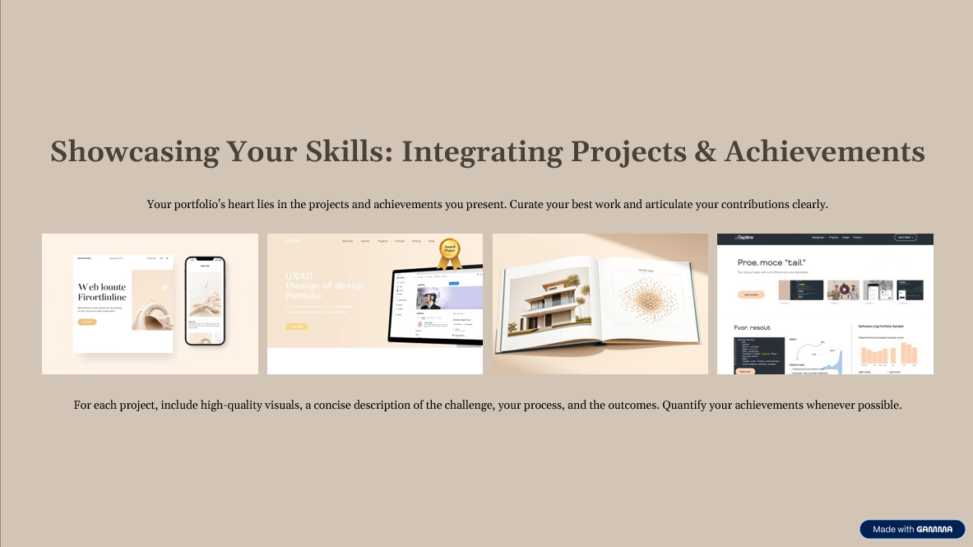

Slide 11


Slide 12
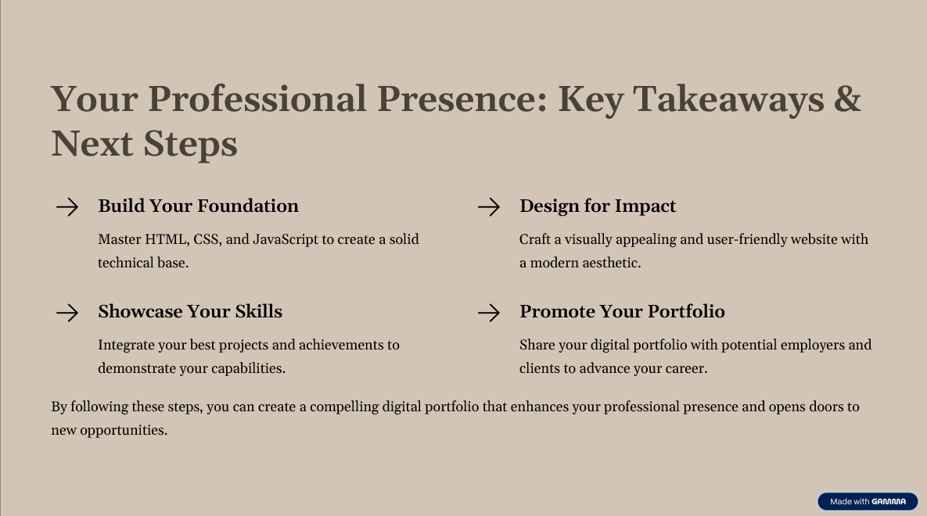

Slide 13
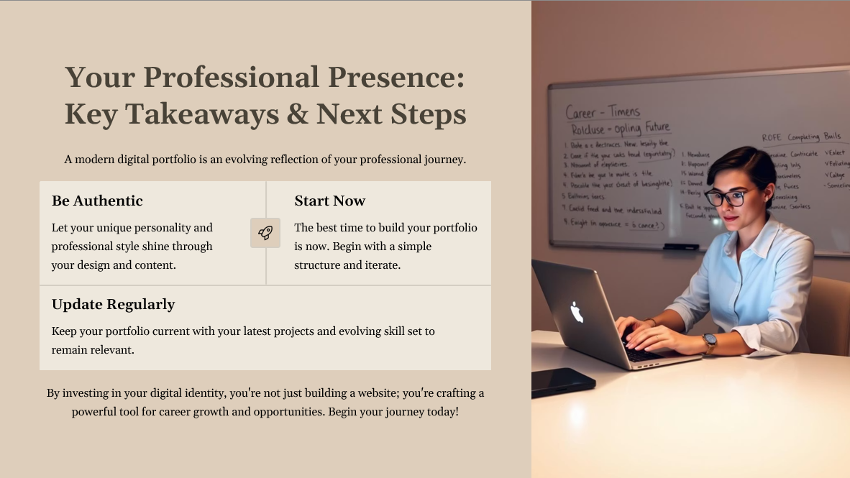

Slide 14
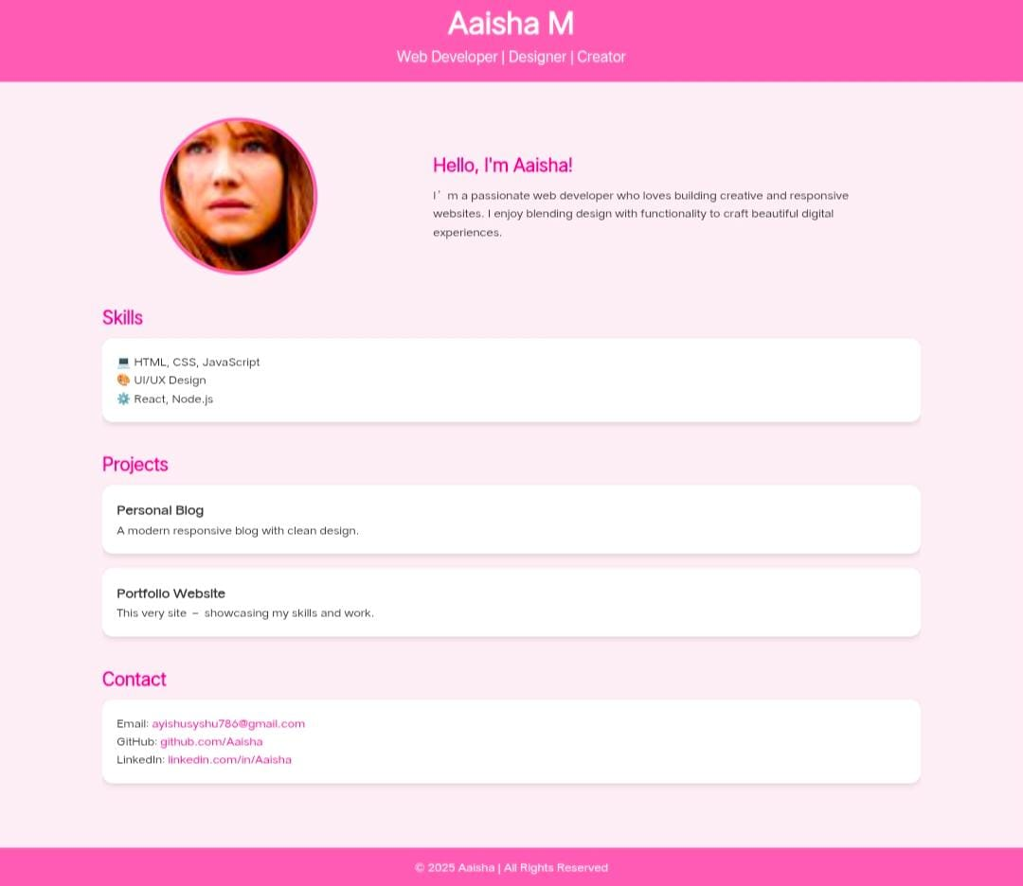

Slide 15

SUMMARY
https://github.com/your-Aaisha/your-repo-Aaisha

Slide 16


Thank you

